Slide 1
A direct bijective proof of the hook-length formula
Jean-Christophe Novelli, Igor Pak and Alexander V. Stoyanovskii
Discrete Mathematics and Theoretical Computer Science,
Vol. 1, pp.53-67, 1997
Date: Sept. 26, 2007
Introducer: Chung-Han Chiang

Slide 2
Abstract
This paper presents a new proof of the hook-length formula, which computes the number of standard Young tableaux of a given shape. After recalling the basic definitions, we present two inverse algorithms giving the desired bijection. The next part of the paper presents the proof of the bijectivity of our construction. The paper concludes with some examples.

Slide 3
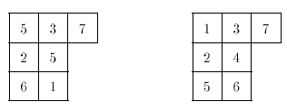
Definitions and Notation
Tableau and standard tableau:
j
(1,1)(1,2)(1,3)
(2,1)
(3,1)
(2,2)
(3,2)
i
Tableau
Standard tableau:
A tableau is said to be ordered up to position (1,1) if the numbers increase from top to bottom along the columns and from left to right along the rows.

Slide 4
Hook-length formula and hook function:
7
5
4
3
1
-2
3
2
1
0
5
3
2
1
-1
0
1
0
1
0
Hook-length formula:
A hook length hx of a box x in Young diagram λ is the number of boxes that are in the same row to the right of it plus those boxes in the same column below it, plus one (for the box itself).
Hook function:
Each cell of the diagram is
filled with an integer between minus the number of cells strictly below in its column and plus the number of cells strictly right of it in its row.

Slide 5
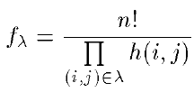
The hook-length formula
f_{λ} is the number of standard tableaux of shape .
The bijection we are going to construct is between the following sets:
I The pairs of the form:
– a standard tableau of shape ,
– a hook function.
II The tableaux of shape .
The bijection consists of two algorithms that are
inverse to each other.

Slide 6
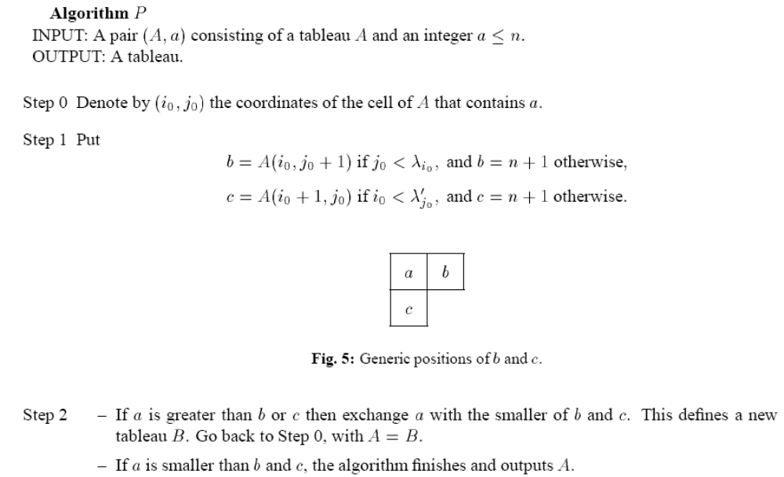
Algorithm II →I

Slide 7
Example:
5
1
1
5
1
3
2
3
2
3
2
5
4
5 > 1, 5 > 2,
Exchange with the small one.
4
5 > 3,
Exchange with 3
4
10
7
5
3
1
: predecessor
9
6
4
2
: successor
8
Totally order the cells of a tableau by reverse lexicographic order on their coordinates

Slide 8
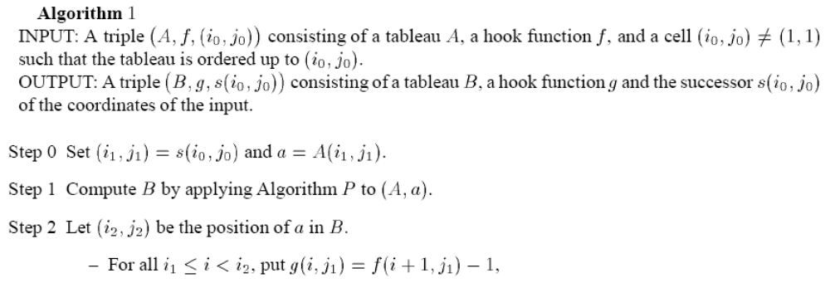
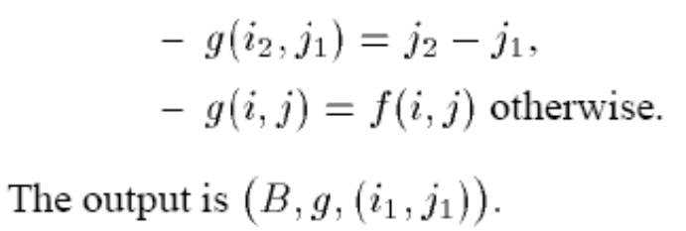

Slide 9
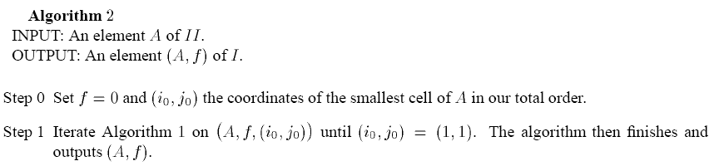

Slide 10
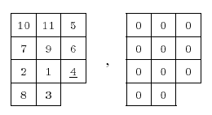
Example1(II→I)
0
0
0
0
0
0
0
0
0
0
0
-1
0
0
0
0
0
0
0
0
0
0
f
g
Tableau A
f (hook function)
s(i₀,j₀) = (i₁,j₁), a = A(i₁,j₁).
s(3,3) = (2,3), a = A(2,3) = 6
Algorithm P to (A,6)
(i₂,j₂) = (3,3)
i₁≦i＜i₂ ( 2≦i＜3 → i = 2 )
g(2,3) = f(2+1,3) – 1 = -1
g(3,3) = 3 – 3 = 0
10
11
5
10
11
5
7
9
6
7
9
4
2
1
4
2
1
6
8
3
8
3
Tableau A
Tableau B

Slide 11
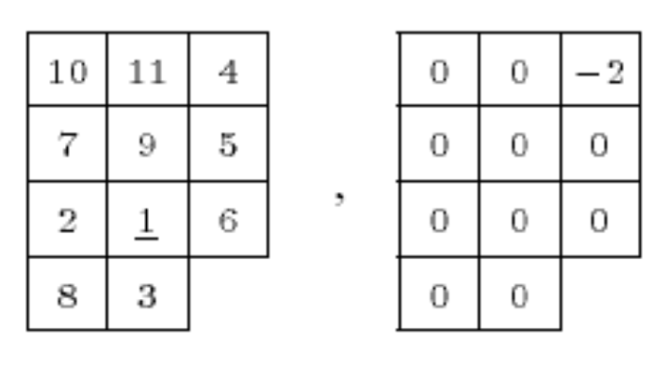
10
11
4
10
11
4
s(i₀,j₀) = (i₁,j₁), a = A(i₁,j₁).
s(3,2) = (2,2), a = A(2,2) = 9
Algorithm P to (A,9)
(i₂,j₂) = (4,2)
i₁≦i＜i₂ ( 2≦i＜4 → i = 2 , 3 )
g(2,2) = f(2+1,2) – 1 = -1
g(3,2) = f(3+1,2) – 1 = -1
g(4,2) = 2 – 2 = 0
7
9
5
7
1
5
2
1
6
2
3
6
8
3
8
9
Tableau A
Tableau B
0
0
-2
0
0
-2
0
0
0
0
-1
0
0
0
0
0
-1
0
0
0
0
0
f
g

Slide 12
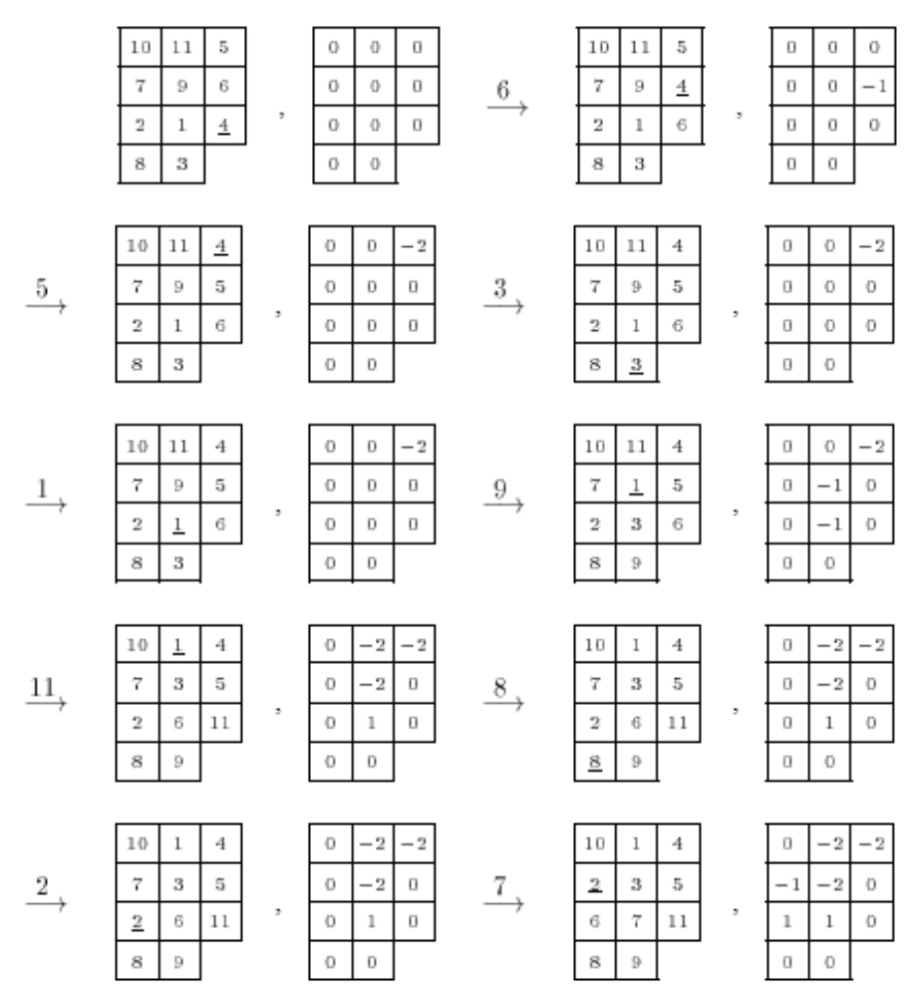
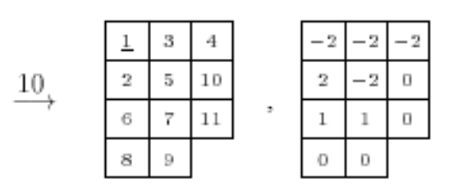
Example1 result

Slide 13
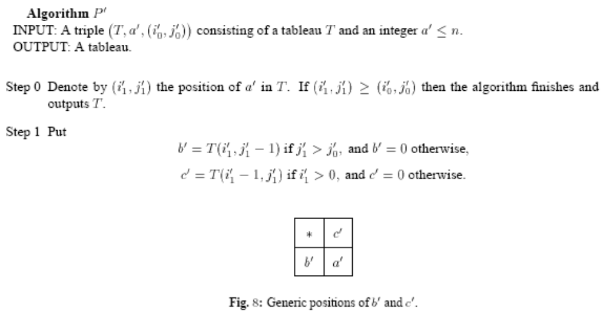
Algorithm I→II

Slide 14
Example:
2
1
6
2
1
6
2
1
8
2
8
1
4
3
7
4
3
8
4
3
6
4
3
6
9
5
8
7 > 5,
Exchange 8 with 7
9
5
7
6 > 3,
Exchange 8 with 6
9
5
7
8 > 1,
Exchange
8 with 1
9
5
7
Definition: candidate
Let U be a tableau, g’ a hook function and (i₁’, j₁’) the coordinates of a cell of U. The set of candidate cells associated with (U; g’; (i₁’; j₁’)) is the set of all cells indexed by (i , j) such that i≧i₁’, g’(i; j₁’) ≧0 and j = j₁’ + g’(i; j₁’).

Slide 15
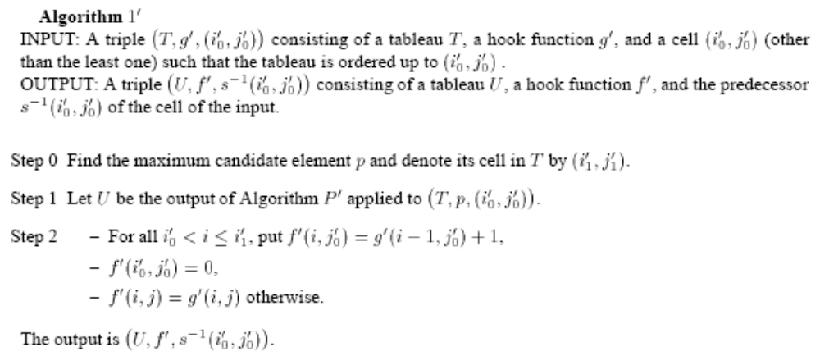

Slide 16
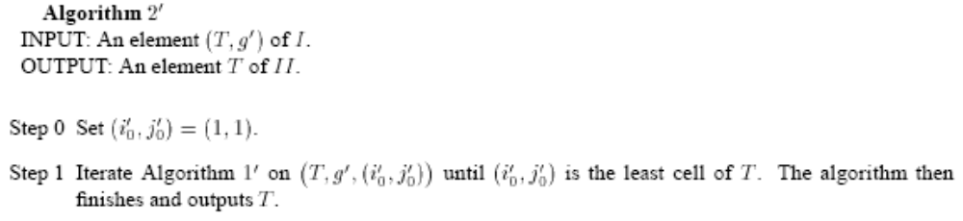

Slide 17
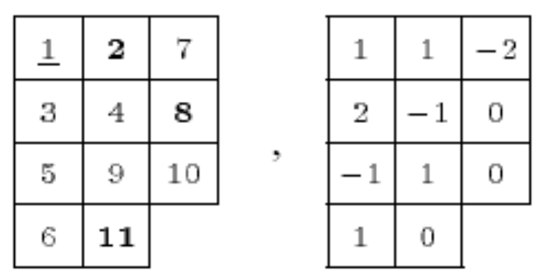
Example2(I→II)
(U, g’, (i₁’,j₁’)) (i₁’,j₁’) = (1,1)
i≧i₁’ , g(i,j₁’) ≧0 , j = j₁’+g’(i,j₁’)
i = 1, 2, 3, 4
g(1,1) =1≧0, j = 1+ g(1,1) = 2
g(2,1) =2≧0, j = 1+ g(2,1) = 3
g(3,1) =-1＜0
g(4,1) =1≧0, j = 1+ g(1,1) = 2
1
2
7
1
2
7
3
4
8
3
4
8
5
9
10
5
9
10
6
11
6
11
Geometrically, we can define the maximum candidate
as the one with the top-most and right-most path.

Slide 18
1
2
7
3
4
8
maximum candidate
(i₁’,j₁’) = (2,3)
5
9
10
6
11
1
2
7
8
1
2
Algorithm p’ to (T,p,(i₀’,j₀’)
(i₀’,j₀’) = (1,1)
3
4
8
3
4
7
5
9
10
5
9
10
6
11
6
11
1
1
-2
0
1
-2
2
-1
0
2
-1
0
-1
1
0
-1
1
0
1
0
1
0
i₀’ ＜ i ≦ i₁’, f’(i,j₀’) =g’(i-1, j₀’) + 1 , f’(i₀’,j₀’) = 0
1 < i ≦ 2, i = 2,
f’(2,1) = g’(1,1) + 1 = 2
f’(1,1) = 0

Slide 19
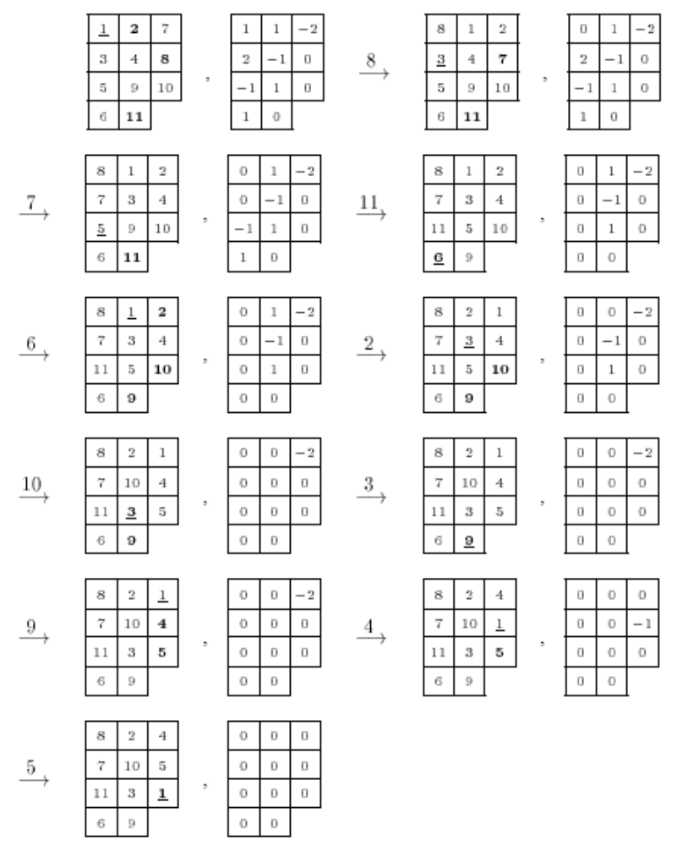
Example2 result

